Slide 1
SCOTTSDALE SYMPOSIUM | 2026
Quantifying the Optical Properties
of Volcanic Ash
to Improve Satellite Retrievals
By Ethan Herrington
Aviation Safety | Remote Sensing | Optical Characterization

Slide 2
MOTIVATION
The Aviation Hazard
✈
⚠
🛰
Engine Damage
Reproducibility
Satellite Detection
In the field of aviation, volcanic ash presents a serious safety risk because it can melt inside jet engines, potentially leading to catastrophic engine failure during flight.
Spectrographs of volcanic ash have previously been produced; however, the methodology used was complex and not easily reproducible.
With this technology, space-based instruments can identify and monitor ash plumes in real time. This capability enables rapid rerouting of aircraft and significantly enhances overall aviation safety.
THE REPEATABILITY PROBLEM
These previous examples were preformed by Reed et al. (2018) and Deguine et al. (2020) They were made using an aerosol cell
Quantifying Optical Properties of Volcanic Ash | Scottsdale Symposium

Slide 3
MOTIVATION
The Variability Problem
Why Optical Properties Matter
ULTIMATE GOAL
Satellite instruments retrieve ash mass loading from radiance measurements
Retrievals assume a fixed set of refractive indices for volcanic ash
Ash composition varies by volcano, eruption style, and particle size
Using incorrect optical properties leads to large errors in ash concentration
Quantify optical
properties for
various types of
volcanic ash
→ Enable more accurate
satellite retrievals
of ash concentration
Quantifying Optical Properties of Volcanic Ash | Scottsdale Symposium

Slide 4
METHODOLOGY
Developing a Repeatable Measurement Method
Goal: Develop a consistent, repeatable method to measure IR optical properties of volcanic ash
01
Prepare KBr Pellet
02
Measure Transmittance
03
Invert Refractive Index
Step 1: Weigh 0.4g of KBr powder
Step 2: Using a mortar and pestle,
grind KBr powder until a
homogeneous consistency
is achieved.
Step 3: Prepare the pellet die and
transfer the KBr powder
into it.
Step 4: Load the die into a press and
pressurize to 100bar
Step 5: Gently remove the formed
pellet from the die.
Place pellet in FTIR spectrometer. Measure spectral transmittance from 400–4000 cm⁻¹ (mid-IR).
Model Mie/Rayleigh scattering to match observed transmittance. Invert to retrieve complex refractive index n+ik.
Quantifying Optical Properties of Volcanic Ash | Scottsdale Symposium

Slide 5
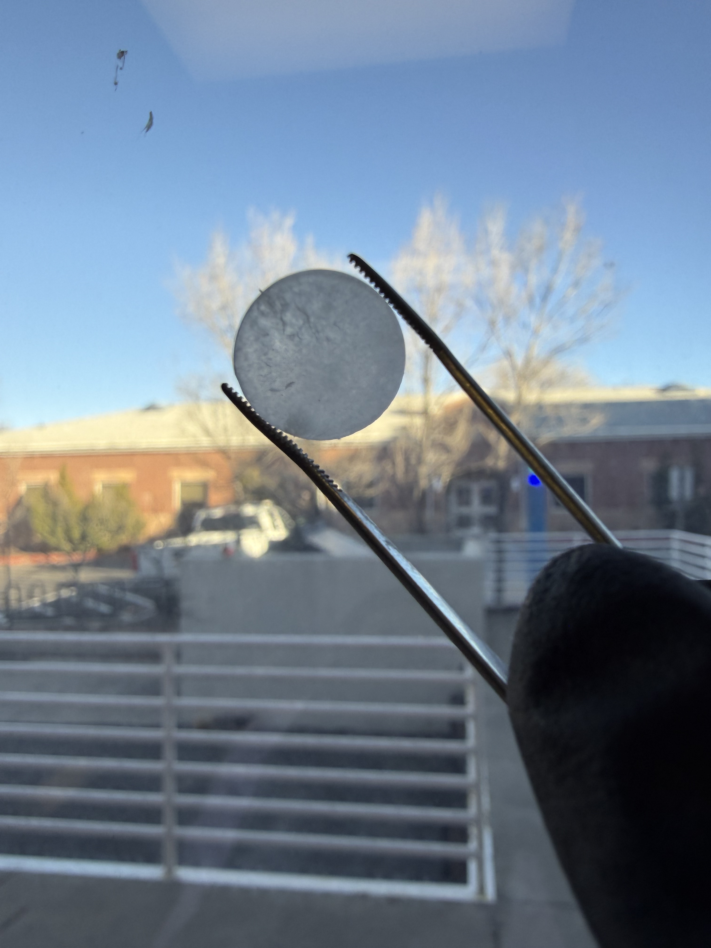
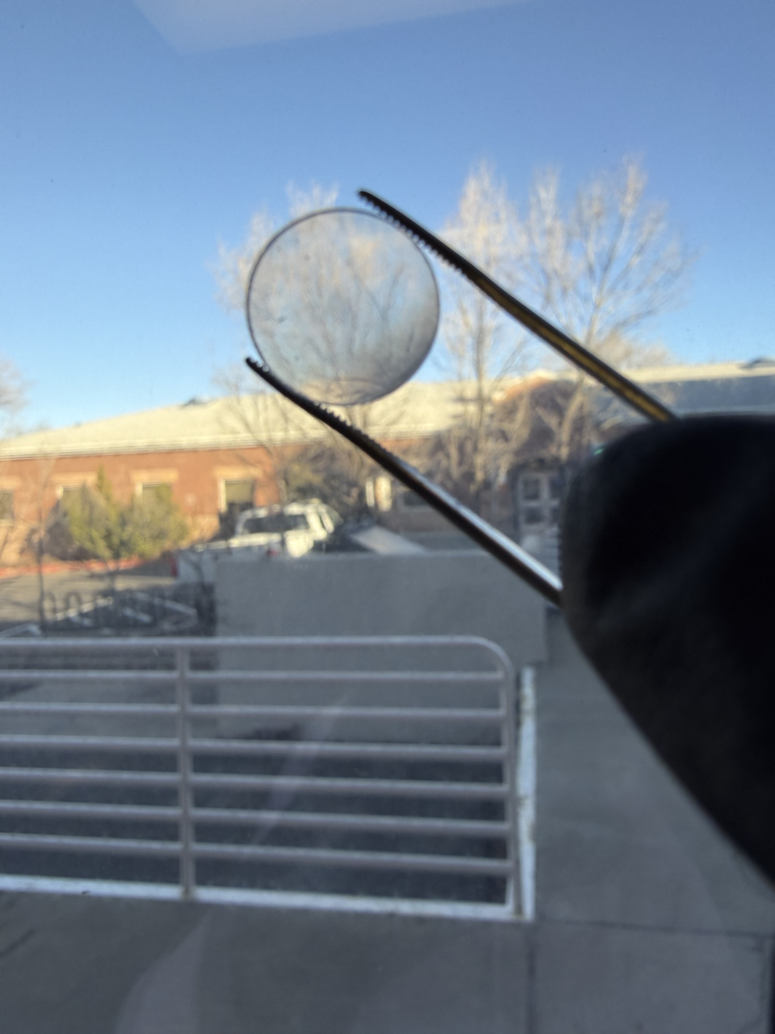
EXPERIMENTAL SETBACKS
Challenges Encountered & Lessons Learned
Water-Logged KBr
While pressing the KBr, atmospheric water would merge with the powder creating contamination.
Photos of pellets before and after changes
Inadequate Pellet Press
The initial pellet press applied uneven pressure, resulting in inconsistent pellet thickness. This issue was primarily due to the press's convex shape, which created non-uniform force distribution.
Solutions
We replaced our die with one that provided an improved seal and more uniform force distribution. Further improvements, such as pressing and heating under vacuum, were not available to us but could enhance sample quality.
Quantifying Optical Properties of Volcanic Ash | Scottsdale Symposium

Slide 6
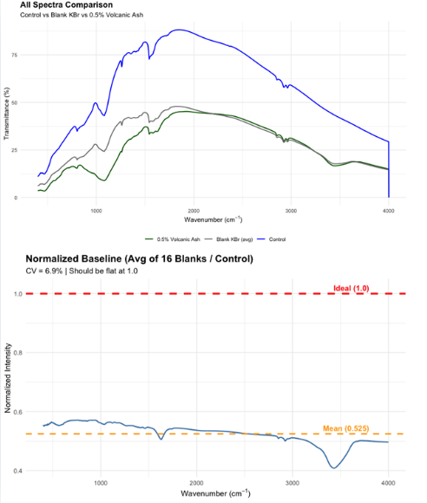
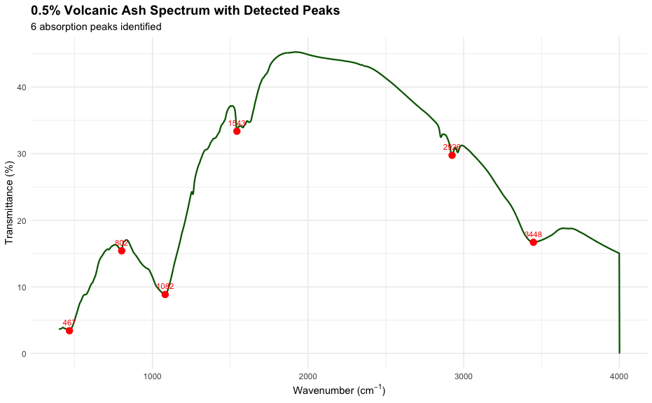
RESULTS
Transmittance Spectra & Current Status
KBr Reference Spectra
KBr 0% Volcanic Ash Spectrum
Achieved consistent, reproducible pure KBr pellet transmittance spectra
Residual water absorption features still visible (~1640 cm⁻¹ and ~3300 cm⁻¹)
Heating KBr prior to pressing did not eliminate water contamination
Vacuum pump during pressing (pending equipment) expected to resolve remaining moisture
KBr 0.5% Volcanic Ash Spectrum
Quantifying Optical Properties of Volcanic Ash | Scottsdale Symposium

Slide 7
CONCLUSIONS
Summary & Path Forward
✓
Developed a consistent, repeatable KBr pellet procedure for measuring ash optical properties
✓
Identified and resolved key experimental setbacks: KBr moisture, press pressure, and die sealing
✓
Consistent results were obtained for pure KBr, along with initial spectral data for ash-doped KBr samples.
→
Vacuum pump integration will eliminate residual water features from spectra
→
Full refractive index inversion pipeline under development for multiple ash types
Thank you | Questions Welcome

